Slide 1

CSC 111 – Introduction to Computing lecture One
C. I EKE
eke.ifeanyi @fulafia.edu.ng

Slide 2
Reference books
The standard textbook for this module is given below
Computer science for fresh undergraduates. Fundermentals of information technology, S.B. Junaidu.
Discovering Computers 2011: Living in a Digital World , Seventh Edition, by: Gary B. Shelly and Misty E. Vermaat, published by Course Technology, Cengage Learning.

Slide 3
Lecturers taking the course
Prof. D.N Choji
C.I Eke (course coordinator)
Umar Bako
P.A Ochang

Slide 4
Course Outline (cont.)

Slide 5
Assessment
Assignments at the end of every lecture
2 Tests
Practical classes
Exam

Slide 6
Introductory Concepts in Computer Science
What is a Computer?
A device which senses / accepts data as inputs, performs operations on the data based on a prearranged sequence of instructions called a program and provides the result as an output.
An electronic device for storing and processing data, typically in binary form, according to instructions given to it in a variable format.

Slide 7
Introductory Concepts in Computer Science
It can also be referred to as an electronics devices / machine that are capable of accepting data as input, processes the data based on the instruction and produces result as an output.

Slide 8
Characteristic of computer System
Despite their differences in shape and size, they share several common basic characteristics.
Speed
Storage ability
No IQ
Accuracy
Versatility
Diligence
Power of Remembering
programmability

Slide 9
Characteristic of computer System
Speed: computers work very fast. A computer has no problem in solving thousands of problems within a second or even microsecond, nanosecond, or pico second.
Storage ability: due to auxiliary storage unit, unlimited amounts of information can be stored in a computer system. This information is never forgotten unless it is deleted, removed or changed. Therefore the information stored inside the computer is reliably stored and easier to retrieve when needed.
NO IQ: computer cannot do any work without instruction from the user. It is the user who decides what the computer should do, how it should be done and the moment the task should be carried out.
Diligence: a computer is free from tiredness, lack of concentration, fatigue, etc . It can work for hours without creating any error.
Power of remembering: computer has the power of storing any amount of information or data and for several years.

Slide 10
Characteristic of computer System
Accuracy: it is a very accurate and reliable machine though not every result is Accurate. Computers nowadays are able to report if the hardware misbehaves while processing information or if the information proceeding from one unit to another is corrupted. They perform finite arithmetic or calculation.
Versatility: the same computer can perform different type of work. The same computer can be used for playing video game, for managing a business, for editing a word document.
Programmability: this is one of the unique characteristics that distinguish computer from other calculating machines (Calculator). A computer can be programmed to perform any desired Operation, ranging from business to Sciences, economy , environmental study.

Slide 11
What Is Computer Science? Some Possible Misconceptions Are:
The study of Computers
Programming and programming languages
Applications software like MS word, Adobe Photoshop, Vlc player, Mp3 player, Video games

Slide 12
A widely accepted definition of Computer science was given by Norman Gibbs and Allen Tucker:
Computer Science is the study of Algorithms, especially their
Mathematical Properties: Correctness, Efficiency, Complexity (time and space)
Hardware Realizations: Logic Gates, Circuits, Architecture
Software Realizations: Programming and Programming Methodologies
Applications to Other Disciplines: Mathematics, Physics, Engineering, Business

Slide 13
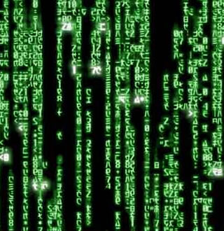
Data
Data are raw facts and figures
that on their own have
no meaning
These can be any alphanumeric
characters i.e. text, numbers,
symbols
Note the “are” bit above? What does this mean

Slide 14
Data Examples
Yes, Yes, No, Yes, No, Yes, No, Yes
42, 63, 96, 74, 56, 86
111192, 111234
None of the above data sets have any meaning until they are given a CONTEXT and PROCESSED into a useable form

Slide 15
Data Into Information
To achieve its aims the organisation will need to process data into information.
Data needs to be turned into meaningful information and presented in its most useful format
Data must be processed in a context in order to give it meaning

Slide 16
Information
Data that has been processed within a context to give it meaning
OR
Data that has been processed into a form that gives it meaning

Slide 17
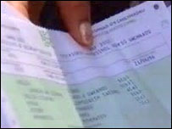
Examples
In the next 3 examples explain how the data could be processed to give it meaning
What information can then be derived from the data?
Suggested answers are given at the end of this presentation

Slide 18
Example 1
Raw Data
Yes, Yes, No, Yes, No, Yes, No, Yes, No, Yes, Yes
Context
Responses to the market research question – “Would you buy brand x at price y?”
Processing
Information
???

Slide 19

Example 2
Raw Data
42, 63, 96, 74, 56, 86
Context
James scores in the six AS/A2 ICT modules
Processing
Information
???

Slide 20
Example 3
Raw Data
111192, 111234
Context
The previous and current readings of a customer’s gas meter
Processing
Information
???

Slide 21
Suggested answers to examples
Example 1
We could add up the yes and no responses and calculate the percentage of customers who would buy product X at price Y. The information could be presented as a chart to make it easier to understand.
Example 2
Adding James scores would give us a mark out of 600 that could then be converted to an A level grade. Alternatively we could convert the individual module results into grades.
Example 3
By subtracting the second value from the first we can work out how many units of gas the consumer has used. This can then be multiplied by the price per unit to determine the customer’s gas bill.

Slide 22
Summary
Information
=
Data
+
Context
+
Meaning
Processing
Data – raw facts and figures
Information – data that has been processed (in a context) to give it meaning

Slide 23
Applications of computer systems
A computer in the growing technology offers a wide range of functions and services. They includes
Education: computers have significantly enhanced the quality of teaching and learning. Internet has helped improving the quality of academic research by making needed materials available to researchers and learners. Distance learning offers a variety of internet and video based online courses. They are used to give online exams and get instant results.
Medicine: it is used to store patient data, diagnose diseases and learn the cures. Software is used in magnetic resonance imaging to examine the internal organs of the human body. Software is used in performing surgery.
Business: it is used to manage stock and sales, to calculate the bills and taxes, accounting is done using computers. One can predict future trends of business using artificial intelligent. Software is used in many stock markets. One can trade online.

Slide 24
Applications of computer systems
Banking: all financial transactions are done by computer software. They provide security, speed, and convenience. Automated teller machine let us conduct banking transaction from virtually anywhere in the world.
Government: various departments of government use computer for their planning, control and law enforcement activities.
Communication: through e-mail, you can communicate with a person sitting thousands of miles away in few seconds. Chat software enables one to chat with another on a real-time basis

Slide 25
Classification of Computers
Classification based on Size
Super Computer
Mainframe Computers
Minicomputer
Microcomputer/ Personal computer
Super Computer: The fastest and most powerful type of computer. Supercomputer are very expenses and are employed for specialized applications that require immense amounts of mathematical calculations. For example, weather forecasting requires supercomputer. Other uses of super computers includes animated graphics, fluid dynamic calculations, nuclear energy research and petroleum exploration. The chief difference between a supercomputer and a mainframe computer is that a supercomputer channels all its power into executing a few programs as fast as possible, whereas mainframe uses its power to execute many programs concurrently.

Slide 26
Classification of Computers
Super Computer: The fastest and most powerful type of computer. Supercomputer are very expenses and are employed for specialized applications that require immense amounts of mathematical calculations. exploration. The chief difference between a supercomputer and a mainframe computer is that a supercomputer channels all its power into executing a few programs as fast as possible, whereas mainframe uses its power to execute many programs concurrently.
Applications
weather forecasting requires supercomputer.
Animated graphics
fluid dynamic calculations.
nuclear energy research and petroleum exploration

Slide 27
Classification of Computers
Mainframe: Largest type of digital computer and a multi user system. Capable of supporting hundreds and thousands of users simultaneously. They are expensive. Require air conditioning for temperature control. Needs many people to operate and maintain them. Mainframe are just below supercomputers and in some way more powerful because they support more simultaneous programs.
Applications
Used as controlling nodes in WANs
Used to manage large centralized databases

Slide 28
Classification of Computers
Minicomputers: Multiuser. Designed for use in a network system. Typically used in applications that don’t require the fast computational speed or large memory capacity available on large scale system. Have program flexibility but are sometimes programmed for a specific job and many times used only for that job. Support faster peripheral devices like high speed printers
Application
Used to control and monitor production processes
To analyze results of experiments in laboratories
Used as servers in LANs (Local Area Networks)

Slide 29
Classification of Computers
Microcomputers: Micros are the smallest of all the classes of computers in physical sizes. They are various kinds of personal computers: desktops, laptops, handheld computers, and Tablet PCs most widely used because of their compatibility e.g. IBM PC, PS/2 and Apple Macintosh
characteristics
They are designed to be used by only one person at a time
A micro Computer uses a microprocessor as its central Processing Unit
Low cost and often used for specific applications.

Slide 30
Types of Computers
Classification based on method of processing.
a. Analog
b. Digital
c. Hybrid
Analog: Works on numerical data represented by some physical quantity which varies continuously i.e. it measures physical changes such as temperature, pressure to model the problem being solved. Such computers do not deal directly with the numbers
Digital: High speed & programmable. They compute values and stores results. Performs calculations & logical operations with quantities represented as digits, usually in binary number. Data is represented in 0s & 1s. They give the results with more accuracy and at a fast rate.

Slide 31
Classification of Computers
Hybrid: Combines both analog & digital features and operations combining the advantages of analog and digital computers when working as a system. Hybrid computers are being used extensively in process control system where it is necessary to have a close representation with the physical world.

Slide 32
Classification of Computers
Classification based on Purpose and usage.
General purpose computers
These machines have the capability of dealing with variety of different problems, and are able to act in response to programs created to meet different needs. A general purpose computer is one that has the ability to store different programs of instruction and thus to perform a variety of operation.
Special purpose computers
As to the name implies, is designed to perform one specific task. The program of instructions is built into, or permanently stored in the machine. Most special purpose computers have the capability of performing just one task.

Slide 33
Classification based on Generation
This refers to the periods and stages of development of computer. This stages or periods started from 1946 to date.
The first electronic Computer was designed and built at the University of Pennsylvania based on vacuum tube technology. Vacuum tubes were used to perform logic operations and to store data.
Generations of Computers has been divided into five according to the development of technologies used to fabricate the processors, memories and I/O units

Slide 34
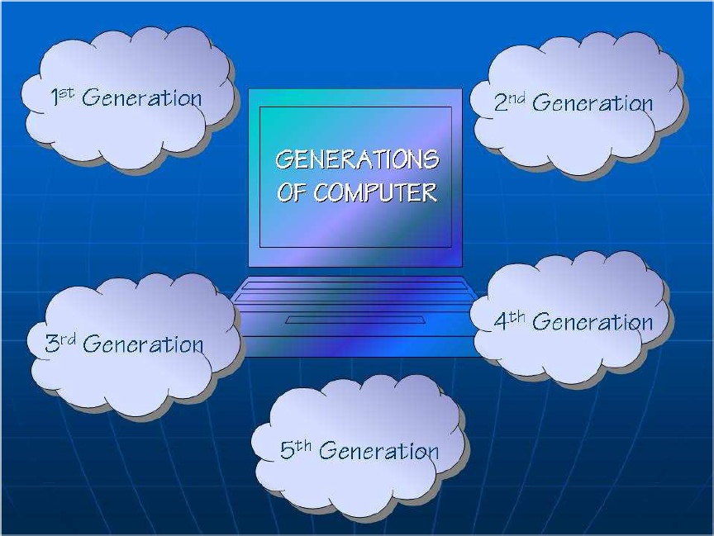
GENERATIONS OF COMPUTER

Slide 35

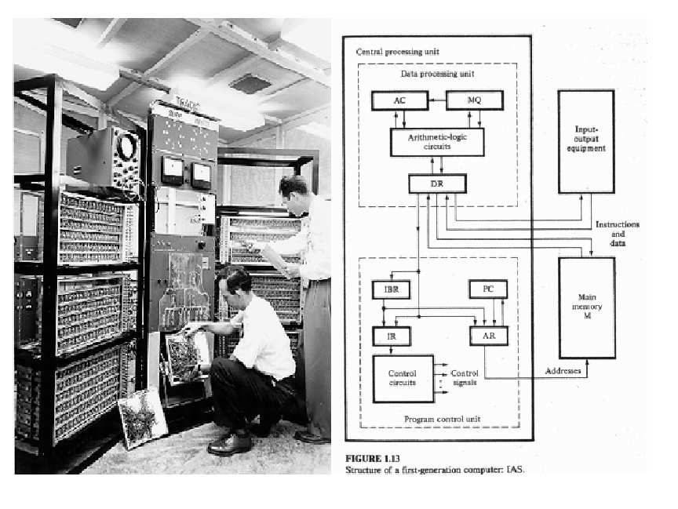
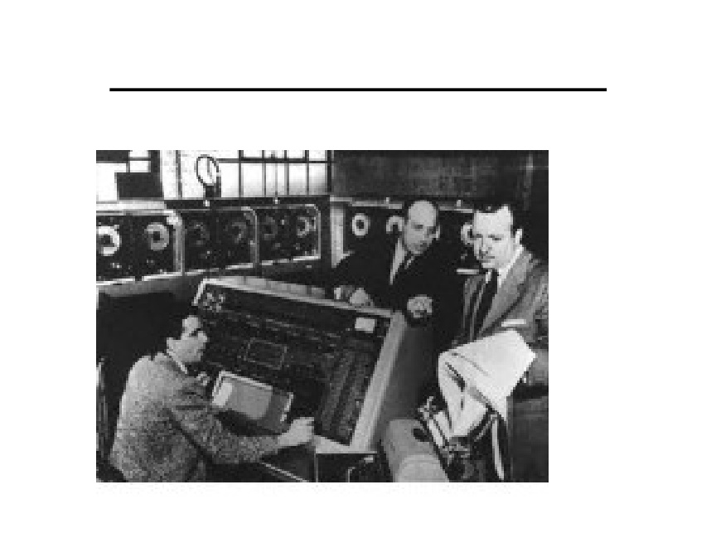

FIRST GENERATION
(VACCUM TUBE TECHNOLOGY) 1946-1958
UNIVAC computer
ENIAC computer

Slide 36
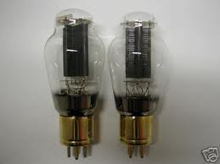
Vacuum tube technology
What are vacuum tubes?
Vacuum tubes are electronic devices that are
used to generate electrical signals

Slide 37
Development of Electronic Computers ( Computer Generations )
First Generation of Computers (1946 – 1958)
Earliest general purpose computers
Its input & output media were punched cards & magnetic tapes respectively
Main memory made up of medium vacuum tubes
They were slow and large
They were very expenses to operate as they used large amount of electricity
They produced a tremendous amount of heat
Fixed point arithmetic were used
Could run only one program at a time

Slide 38

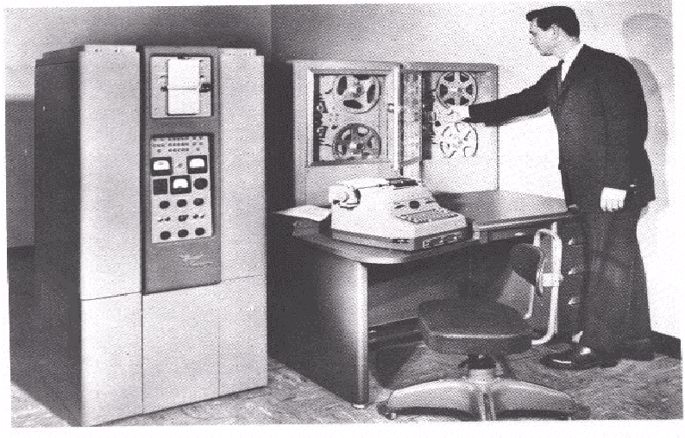
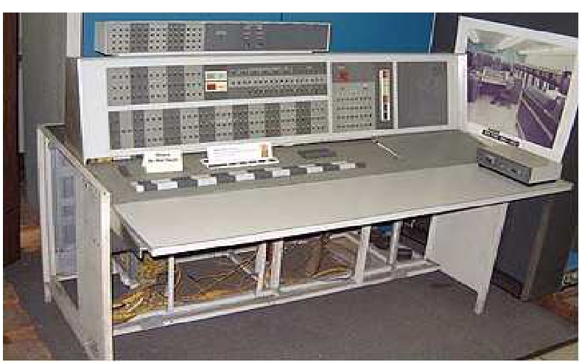
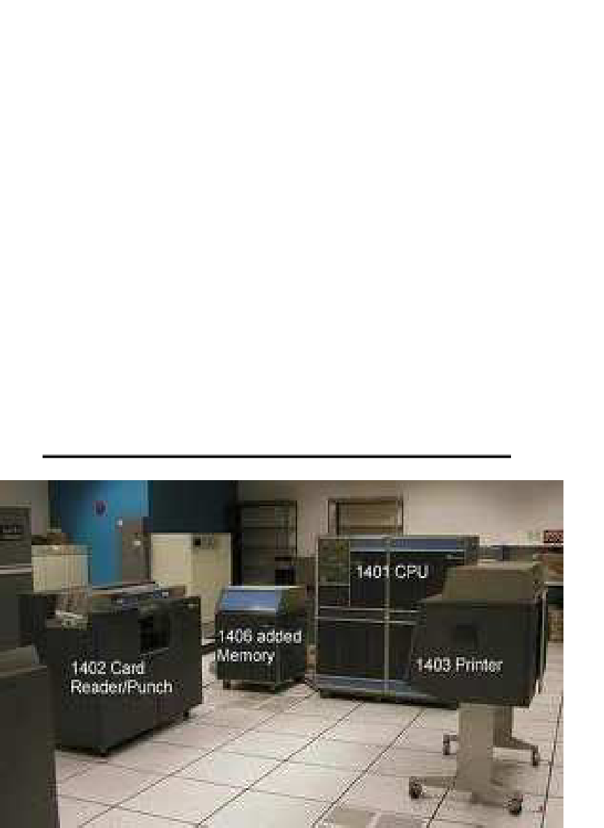
SECOND GENERATION COMPUTERS
1959-1964 (TRANSISTOR AGE)
IBM 7094
IBM 1401, 1402, 1403 and 1406

Slide 39

Do you know that........?
The transistor (short for transfer resistance) is made up of semi-conductor and is a component used to control the amount of current or voltage or used for amplification/modulation or switching of an electronic signal. The transistor is the primary building block of all microchips, including your CPU, and is what creates the binary 0's and 1's your computer uses to communicate.

Slide 40
Computer Generations (cont.)
Second Generation of Computers (1959–1964)
Transistors replaced vacuum tubes
Memory made up of magnetic cores
Uses removable magnetic disk packs as storage devices
High level programming language such as FORTRAN and COBOL were used
Hardware for floating point arithmetic operations were developed
Computational time were reduced to microseconds from milliseconds
Flexibility of program were increased as a result of index register
They are smaller, more reliable and significantly faster than the first generation
Uses solid state devices such as transistors, which generate less heat and are more reliable

Slide 41

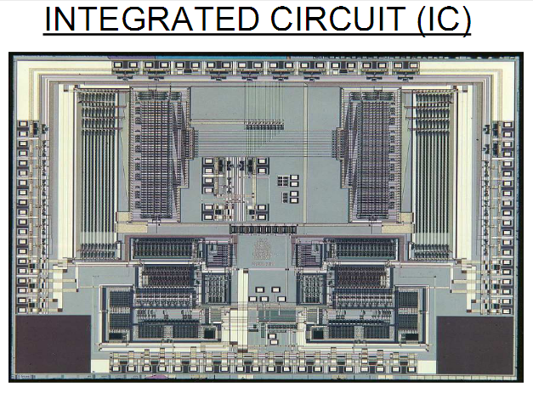
Third Generation Computers 1965-1970
(Integrated Circuit (IC) Technology)

Slide 42
Computer Generations (cont.)
Third Generation of Computers (1965 – 1970)
Integrated circuit – a complete electronic circuit on a silicon chip – replace transistorized circuitry
In the beginning magnetic core memories were used. Later they were
replaced by semiconductor memories (RAM & ROM)
Computer began to support such capabilities as multiprogramming and timesharing
Increase in production of operating systems and application packages
More decrease in size of computers
Allows flexibility in modifying or expanding computer systems without altering the basic system
General purpose computers that handle both business & scientific applications
Computational time reduced from microseconds to nanosecond

Slide 43
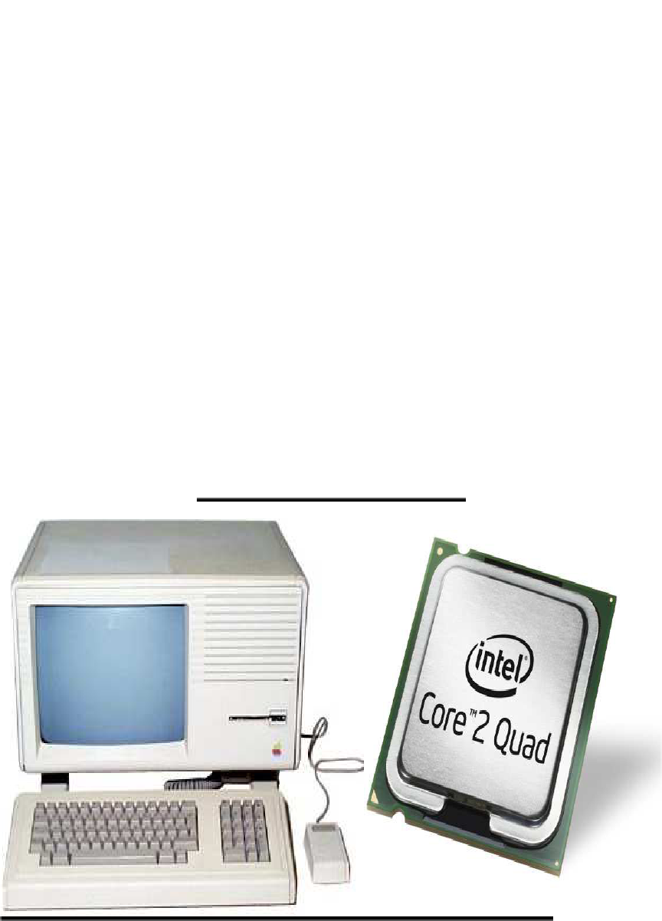
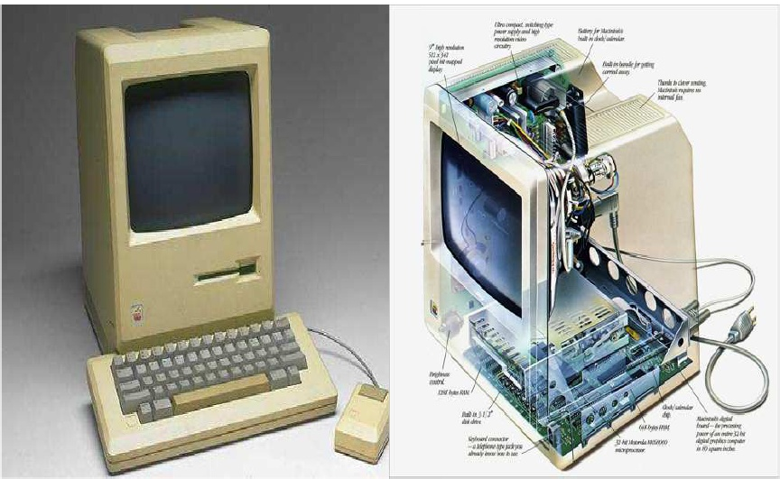
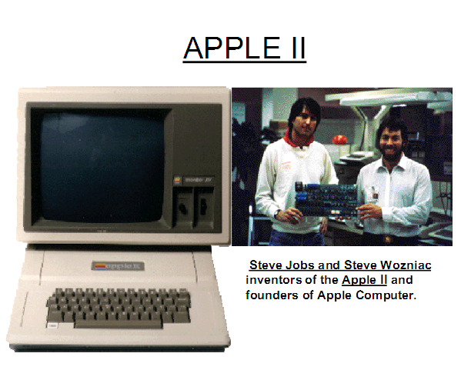
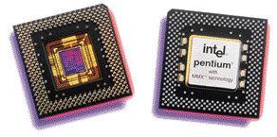
Fourth Generation 1971- 1989(MICRO PROCESSOR AGE)
APPLE MACINTOSH

Slide 44
Fourth Generation 1971- 1989 (MICRO PROCESSOR AGE)
Microprocessor based systems
Electronic computers that used large-scale integration (LSI) circuits
Portable and quite reliable
Generate negligible amount of heat
GUI and pointing devices enables users to learn computer usage quickly
Interconnections of computer leads to better communication and resource sharing
Tens of thousands of transistors can be placed in a single chip (VLSI design implemented)
CRT screen, laser & ink jet printers, scanners were developed.
Semiconductor memory chips were used as the main memory.

Slide 45
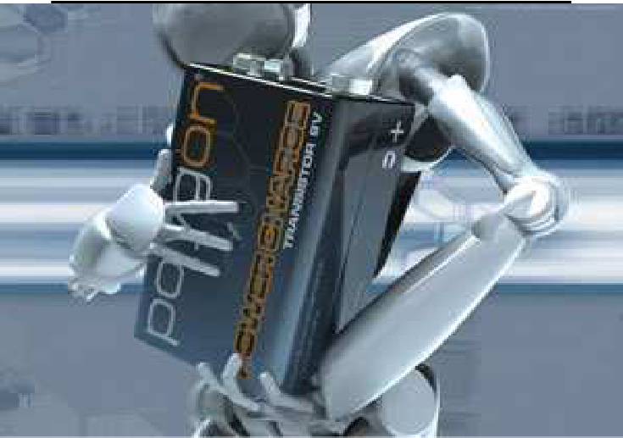
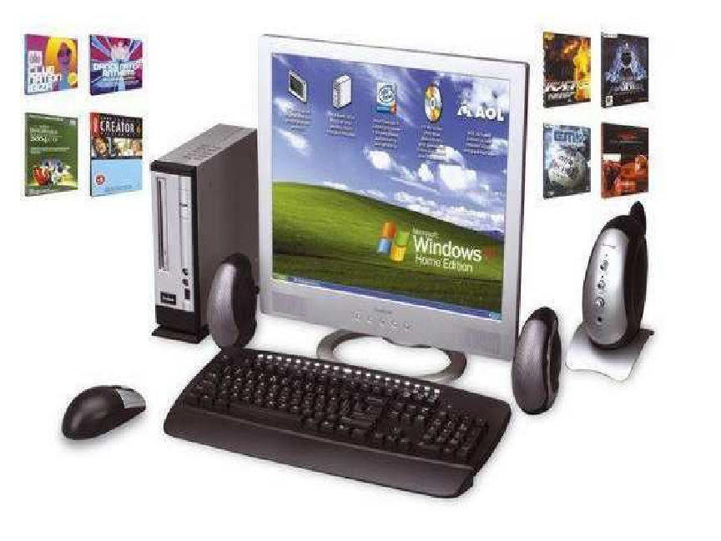
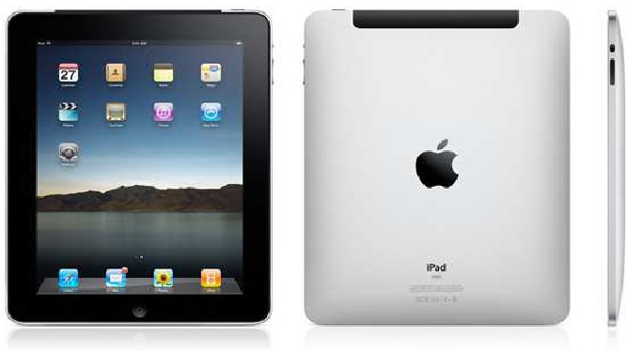
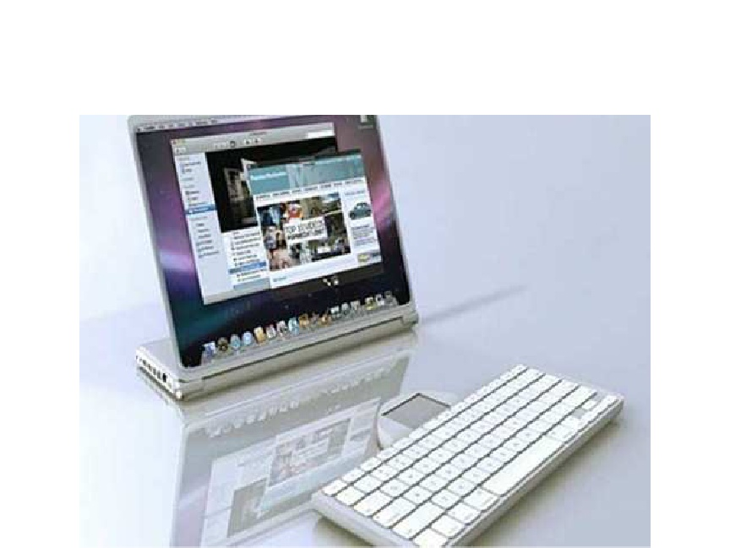
Fifth Generation 1989 - Present
(Artificial Intelligent)

Slide 46

Fifth Generation 1989 - Present
(Artificial Intelligent)
Computers based on artificial intelligence are available
Massive parallel machines and extensively distributed system connected by communication networks
Object Oriented Programming (OOP) language like JAVA suitable for internet programming has been developed
Portable note book Computers were introduced
New operating systems developed – Windows 95/98/XP/, LINUX
Computers use extensive parallel processing, multiple pipelines and multiple processors.
Introduced ULSI (Ultra Large Scale Integration) technology

Slide 47

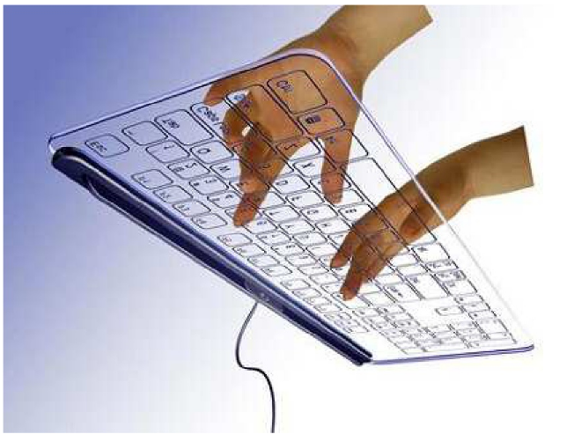
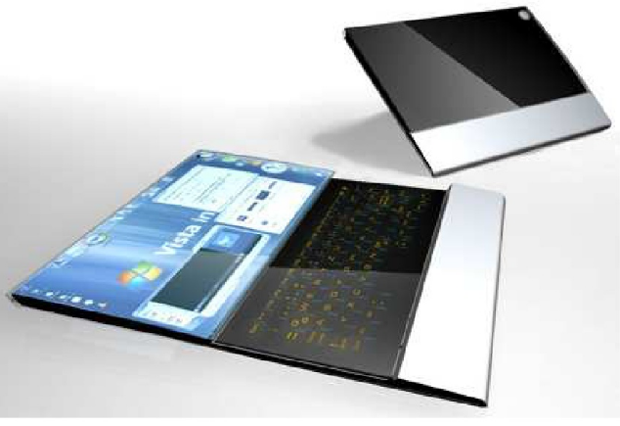
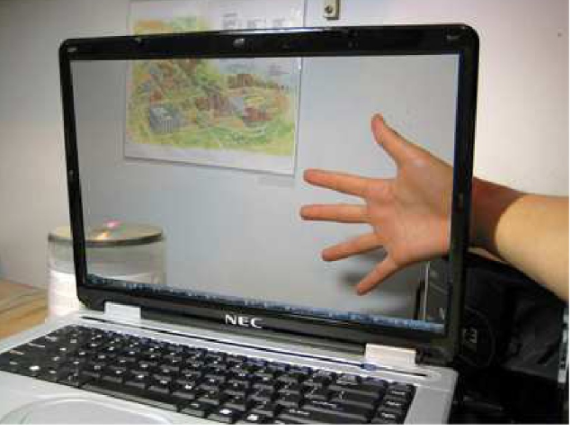
THE LATEST TECHNOLOGY THAT ARE YET TO BE RELEASED

Slide 48

Computer Generations (cont.)
SUMMARY
Generation Technology
First Vacuum tubes
Second Transistors
Third Integrated Circuits (chips)
Fourth Microprocessor
Fifth Artificial intelligent

Slide 49
